Slide 1
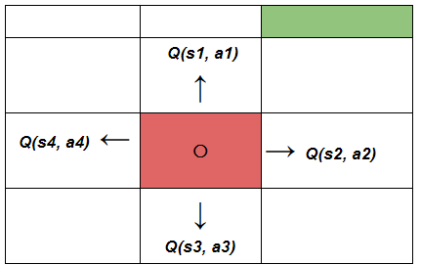
L7.2 Value-based RL
Zonghua Gu 2021
Acknowledgement: slides based on https://www.coursera.org/specializations/reinforcement-learning
And textbook by Sutton and Barto http://incompleteideas.net/book/the-book-2nd.html
Notes:
https://blog.floydhub.com/an-introduction-to-q-learning-reinforcement-learning/

Slide 2
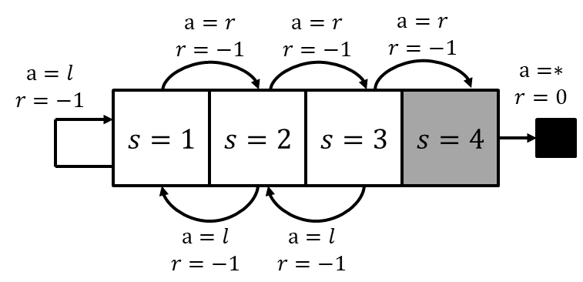
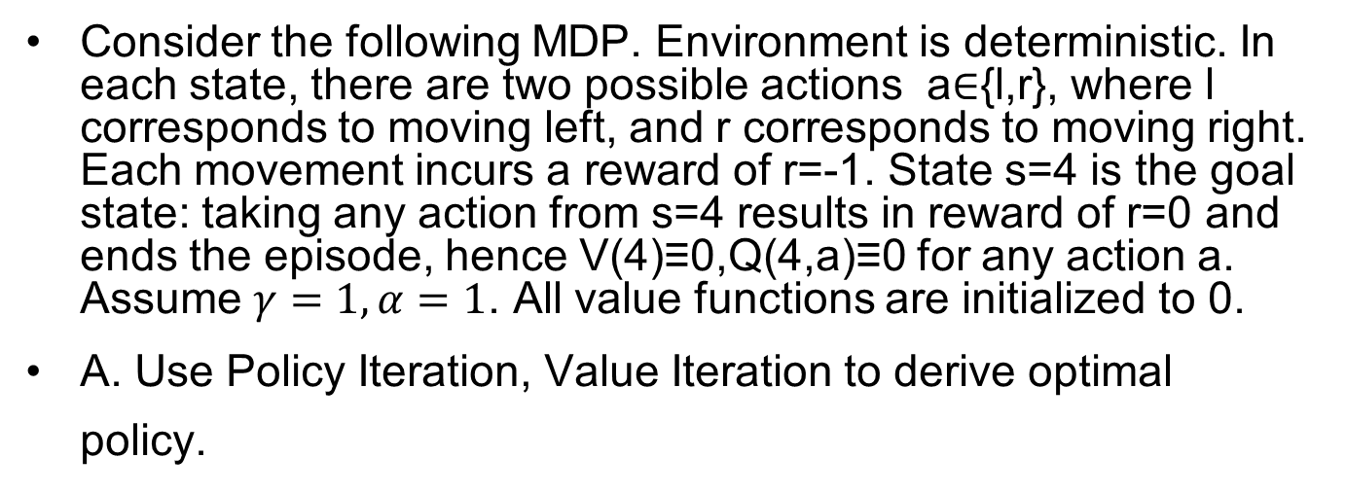
Toy Example
Consider the following MDP. Environment is deterministic. In each state, there are two possible actions a∈{l,r}, where l corresponds to moving left, and r corresponds to moving right. Each movement incurs a reward of r=-1. State s=4 is the goal state: taking any action from s=4 results in reward of r=0 and ends the episode, hence V(4)≡0,Q(4,a)≡0 for any action a. Assume $γ=1, α=1$. All value functions are initialized to 0.
A. Use Policy Iteration, Value Iteration to derive optimal policy.

Slide 3
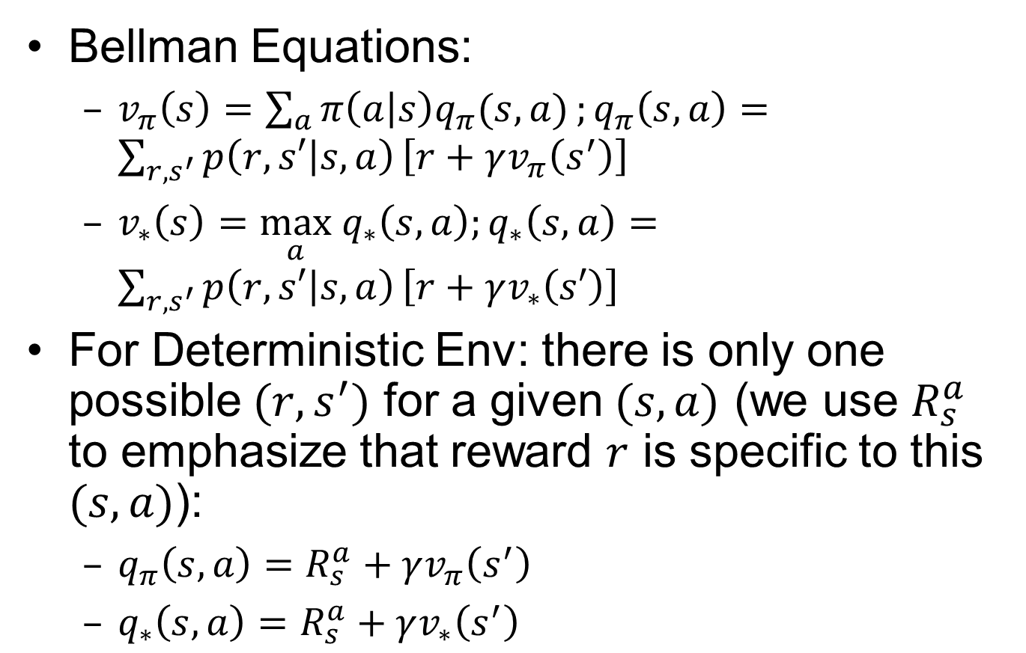
Recall: Simplified Bellman Equations for Deterministic Env
Bellman Equations:
$v_{π}\left(s\right)=\sum_{a}{π\left(a | s\right)q_{π}(s,a)};q_{π}\left(s,a\right)=\sum_{{r, s}^{′}}{p\left(r,s′ | s,a\right)}\left[r+γv_{π}\left(s^{′}\right)\right]$
$v_{∗}\left(s\right)=\max_{a} q_{∗}\left(s,a\right);q_{∗}\left(s,a\right)=\sum_{{r, s}^{′}}{p\left(r,s′ | s,a\right)}\left[r+γv_{∗}\left(s′\right)\right]$
For Deterministic Env: there is only one possible $(r,s^{′})$ for a given $(s,a)$ (we use $R_{s}^{a}$ to emphasize that reward $r$ is specific to this $(s,a)$):
$q_{π}\left(s,a\right)=R_{s}^{a}+γv_{π}\left(s^{′}\right)$
$q_{∗}\left(s,a\right)=R_{s}^{a}+γv_{∗}\left(s^{′}\right)$

Slide 4
Policy Iteration

Slide 5
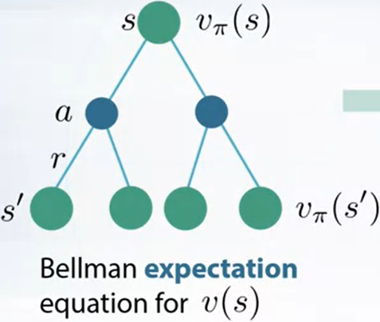
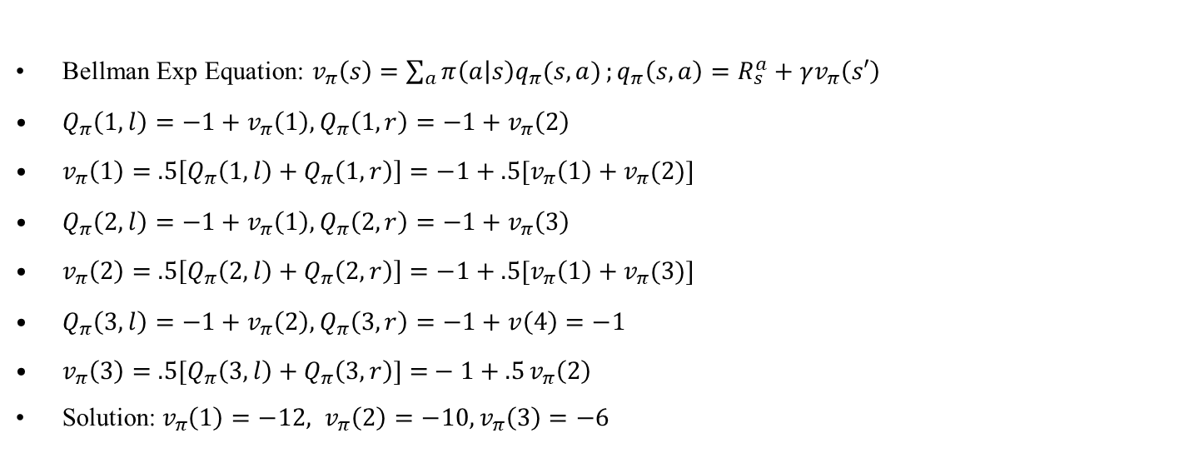
1.1 Policy Evaluation of Random Policy
BF=2
BF=1
Bellman Exp Equation: $v_{π}\left(s\right)=\sum_{a}{π\left(a | s\right)q_{π}(s,a)};q_{π}\left(s,a\right)=R_{s}^{a}+γv_{π}\left(s′\right)$
$Q_{π}\left(1,l\right)=−1+v_{π}\left(1\right),Q_{π}\left(1,r\right)=−1+v_{π}\left(2\right)$
$v_{π}\left(1\right)=$ $.5\left[Q_{π}\left(1,l\right)+Q_{π}\left(1,r\right)\right]=−1+.5[v_{π}\left(1\right)+v_{π}(2)]$
$Q_{π}\left(2,l\right)=−1+v_{π}\left(1\right),Q_{π}\left(2,r\right)=−1+v_{π}\left(3\right)$
$v_{π}\left(2\right)=$ $.5\left[Q_{π}\left(2,l\right)+Q_{π}\left(2,r\right)\right]=−1+.5[v_{π}\left(1\right)+v_{π}(3)]$
$Q_{π}\left(3,l\right)=−1+v_{π}\left(2\right),Q_{π}\left(3,r\right)=−1+v\left(4\right)=−1$
$v_{π}\left(3\right)=$ $.5[Q_{π}\left(3,l\right)+Q_{π}\left(3,r\right)]{=}−1+.5{v_{π}\left(2\right)}$
Solution:$v_{π}\left(1\right)=−12, v_{π}\left(2\right)=−10, v_{π}\left(3\right)=−6$
-12
-10
-6

Slide 6
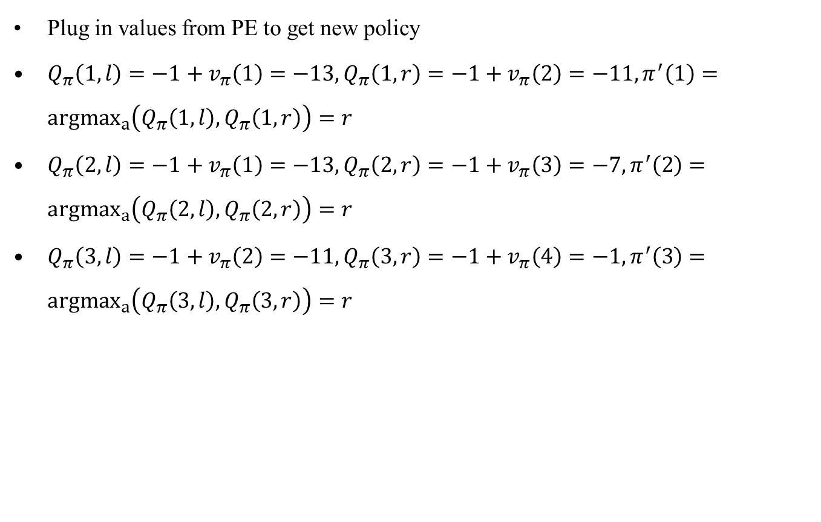
1.2 Policy Improvement
Plug in values from PE to get new policy
$Q_{π}\left(1,l\right)=−1+v_{π}\left(1\right)=−13,Q_{π}\left(1,r\right)=−1+v_{π}\left(2\right)=−11,π^{′}\left(1\right)={argmax}_{a}\left(Q_{π}\left(1,l\right),Q_{π}\left(1,r\right)\right)=r$
$Q_{π}\left(2,l\right)=−1+v_{π}\left(1\right)=−13,Q_{π}\left(2,r\right)=−1+v_{π}\left(3\right)=−7,π^{′}\left(2\right)={argmax}_{a}\left(Q_{π}\left(2,l\right),Q_{π}\left(2,r\right)\right)=r$
$Q_{π}\left(3,l\right)=−1+v_{π}\left(2\right)=−11,Q_{π}\left(3,r\right)=−1+v_{π}\left(4\right)=−1,π^{′}\left(3\right)={argmax}_{a}\left(Q_{π}\left(3,l\right),Q_{π}\left(3,r\right)\right)=r$
-12
-10
-6

Slide 7

2.1 Policy Evaluation of Det Policy
BF=1
BF=1
$Q_{π}\left(1,r\right)=−1+v_{π}\left(2\right)$
$v_{π}\left(1\right)=$ $1Q_{π}\left(1,r\right)=−1+v_{π}\left(2\right)$
$Q_{π}\left(2,r\right)=−1+v_{π}\left(3\right)$
$v_{π}\left(2\right)=$ $1Q_{π}\left(2,r\right)=−1+v_{π}\left(3\right)$
$Q_{π}\left(3,r\right)=−1+v_{π}\left(4\right)=−1$
$v_{π}\left(3\right)=$ $1Q_{π}\left(3,r\right)=−1$
Solution:$v_{π}\left(1\right)=−3, v_{π}\left(2\right)=−2, v_{π}\left(3\right)=−1$
-3
-2
-1

Slide 8
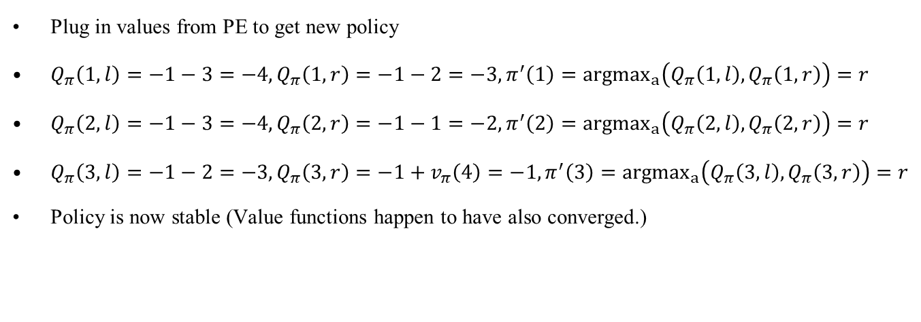
2.2 Policy Improvement
Plug in values from PE to get new policy
$Q_{π}\left(1,l\right)=−1−3=−4,Q_{π}\left(1,r\right)=−1−2=−3,π^{′}\left(1\right)={argmax}_{a}\left(Q_{π}\left(1,l\right),Q_{π}\left(1,r\right)\right)=r$
$Q_{π}\left(2,l\right)=−1−3=−4,Q_{π}\left(2,r\right)=−1−1=−2,π^{′}\left(2\right)={argmax}_{a}\left(Q_{π}\left(2,l\right),Q_{π}\left(2,r\right)\right)=r$
$Q_{π}\left(3,l\right)=−1−2=−3,Q_{π}\left(3,r\right)=−1+v_{π}\left(4\right)=−1,π^{′}\left(3\right)={argmax}_{a}\left(Q_{π}\left(3,l\right),Q_{π}\left(3,r\right)\right)=r$
Policy is now stable (Value functions happen to have also converged.)
-3
-2
-1

Slide 9
Value Iteration

Slide 10
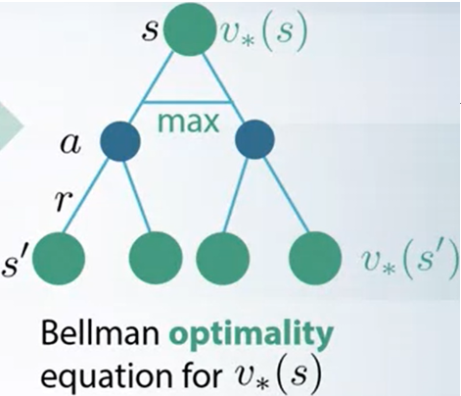
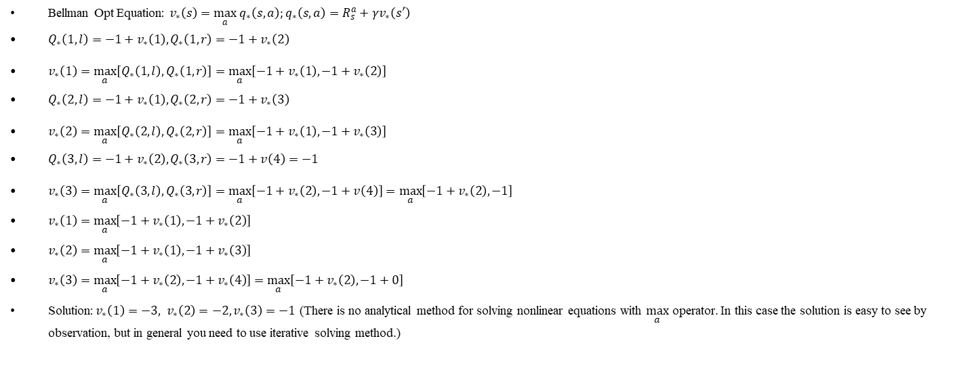
Iter1 Value Iteration
BF=2
BF=1
Bellman Opt Equation: $v_{∗}\left(s\right)=\max_{a} q_{∗}\left(s,a\right);q_{∗}\left(s,a\right)=R_{s}^{a}+γv_{∗}\left(s′\right)$
$Q_{∗}\left(1,l\right)=−1+v_{∗}\left(1\right),Q_{∗}\left(1,r\right)=−1+v_{∗}\left(2\right)$
$v_{∗}\left(1\right)=\max_{a}\left[Q_{∗}\left(1,l\right),Q_{∗}\left(1,r\right)\right]=\max_{a}\left[−1+v_{∗}\left(1\right),−1+v_{∗}\left(2\right)\right]$
$Q_{∗}\left(2,l\right)=−1+v_{∗}\left(1\right),Q_{∗}\left(2,r\right)=−1+v_{∗}\left(3\right)$
$v_{∗}\left(2\right)=\max_{a}\left[Q_{∗}\left(2,l\right),Q_{∗}\left(2,r\right)\right]=\max_{a}\left[−1+v_{∗}\left(1\right),−1+v_{∗}\left(3\right)\right]$
$Q_{∗}\left(3,l\right)=−1+v_{∗}\left(2\right),Q_{∗}\left(3,r\right)=−1+v\left(4\right)=−1$
$v_{∗}\left(3\right)=\max_{a}\left[Q_{∗}\left(3,l\right),Q_{∗}\left(3,r\right)\right]=\max_{a}\left[−1+v_{∗}\left(2\right),−1+v\left(4\right)\right]=\max_{a}\left[−1+v_{∗}\left(2\right),−1\right]$
$v_{∗}\left(1\right)=$ $\max_{a}\left[−1+v_{∗}\left(1\right),−1+v_{∗}\left(2\right)\right]$
$v_{∗}\left(2\right)=$ $\max_{a}\left[−1+v_{∗}\left(1\right),−1+v_{∗}\left(3\right)\right]$
$v_{∗}\left(3\right)=$ $\max_{a}\left[−1+v_{∗}\left(2\right),−1+v_{∗}\left(4\right)\right]=\max_{a}\left[−1+v_{∗}\left(2\right),−1+0\right]$
Solution:$v_{∗}\left(1\right)=−3, v_{∗}\left(2\right)=−2, v_{∗}\left(3\right)=−1$ (There is no analytical method for solving nonlinear equations with $\max_{a}$ operator. In this case the solution is easy to see by observation, but in general you need to use iterative solving method.)
-3
-2
-1
Notes:
Bellman Opt Equation: $v_{∗}\left(s\right)=$ $\max_{a}{\sum_{r,s^{′}}{p\left(r,s′ | s,a\right)}\left[r+γv_{∗}\left(s^{′}\right)\right]}$

